Slide 1

Smart personal Lockers of tomorrow An application of IoT at scale in real world

Slide 2
What is my project about? Motivation
It focuses on exploring an improved version of a home delivery system that can help cut down the costs of parcel deliveries, improving on the current solutions by ensuring that the process can be carried out at any hour, day or night without needing any involvement from the customer.
Think of it as a personal Amazon Locker
The following questions/facts have driven my ambition to do this project:
Why there must be somebody home when I expect a delivery?
Why can’t I order this to be delivered in my preferred location –Amazon locker or Pickup Location
Courier late, again?
How could I miss that delivery attempt? I was just near the door
What about night deliveries? That would be much better for both me and the courier companies/retailers.
Pickup location opening times? Amazon locker opening times?
The current system works offline, as well as having a second power source in case the main power source gets cut. The power will last around 6 hours, time in which the customer is notified about the remaining time to get the parcel from the locker or change the delivery destination before shutting down.

Slide 3

Last mile delivery
Over the last ten years, consumers increasingly turned to e-commerce for most of their shopping due to being more convenient and easier than going physically to buy the products. Fast deliveries are not anymore just “nice to have”, instead it is a must as the customer wants their products as fast as possible.
This translate into a continuous growth, 2018 hitting 602 million euros in online transactions in Europe alone. This is a small number compared to the worldwide trend accounting for 1.86 trillion US dollars for 2016 with a prediction of more than 4.48 trillion by 2021
But this continuous growth comes with an issue that needs to be addressed. In a world where everything must be available anywhere and anytime with the fastest service, end-to-end supply chains become a critical aspect of any successful e-commerce company.
The biggest challenge nowadays is to deliver the parcel when it is convenient for both the customer and sender such that the final cost is not increased unnecessarily.
This is called “last mile delivery” and it represents the end-stage logistics transporting the orders to the buyers from a collection point (a warehouse for example) and accepting returned products in a manner that
We can find quite a lot of different approaches to solve this problem ,some of them more efficient than others such as …..

Slide 4
Current solutions
Issues with them?:
Lockers opening times
Distance from your home/job
Availability
Restrictions
For the aforementioned issues we can already find solutions such as :
Amazon/DHL/InPost delivery lockers
Pickup points
Personal Parcel Lockers
2 hours/1 day delivery

Slide 5
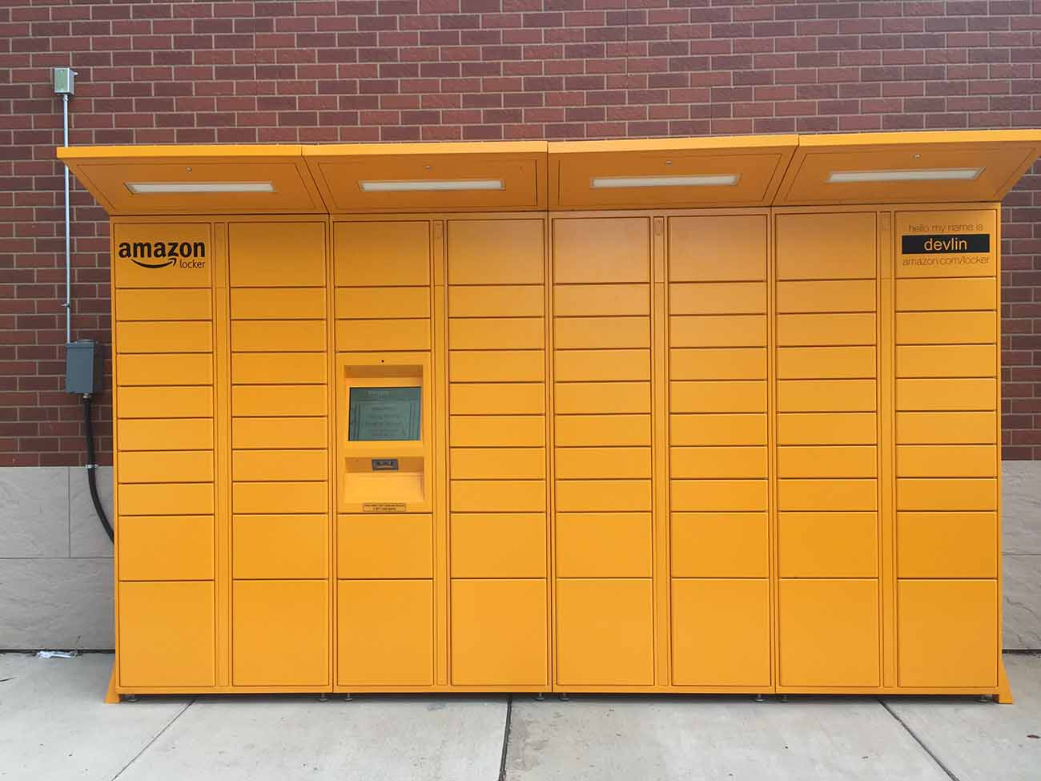
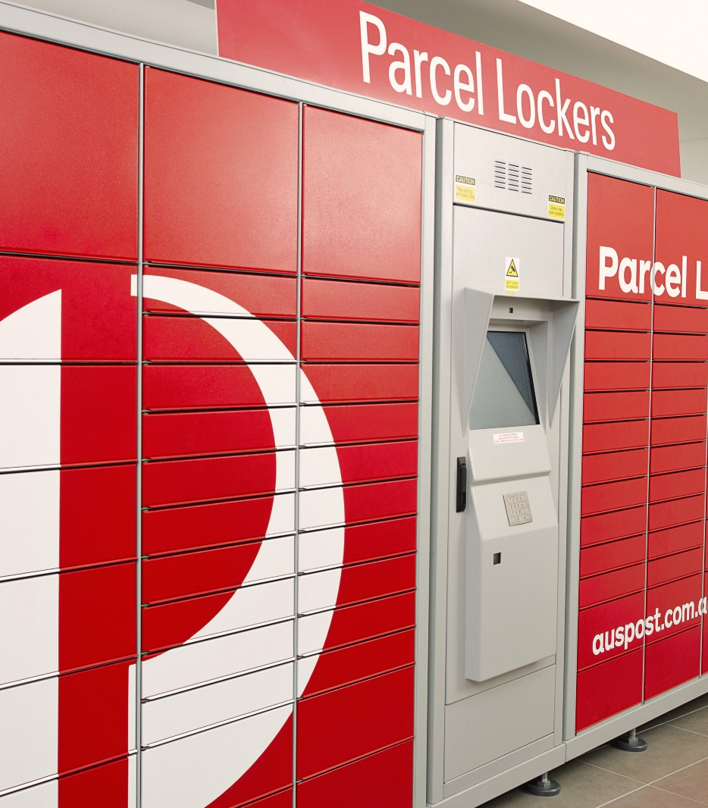
Some examples

Slide 6

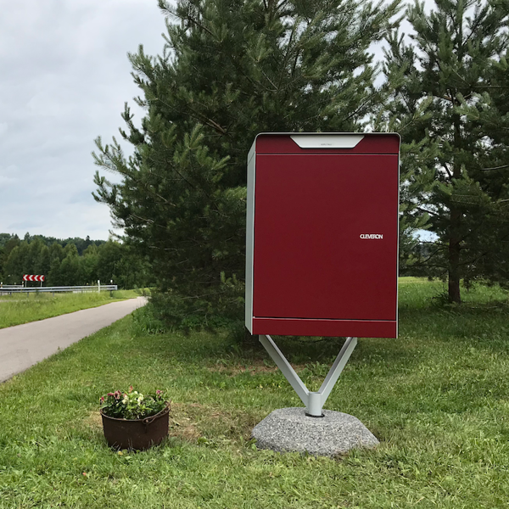
Or even better -From Cleveron

Slide 7
Literature Gaps
The previous examples are current solutions to the last delivery problem that try to minimize the cost of deliveries.
My solution try to build on these, using a pin approach, and comes with more features such as:
Total control over the smart locker –Status Completed
Full notification system for every action that happens to the locker (pickup/delivery/power outrage)- Status Completed
Ability to let others pick items for you if you are not home (friends) or the locker losses power - Status Completed
Ability to track who delivered your parcel (Courier company and time)-Status completed - Status Completed
Ability to manually open/close the locker whenever you want and from anywhere in the world. - Status Completed (but not yet deployed)

Slide 8

Methodology
Hardware and Software

Slide 9
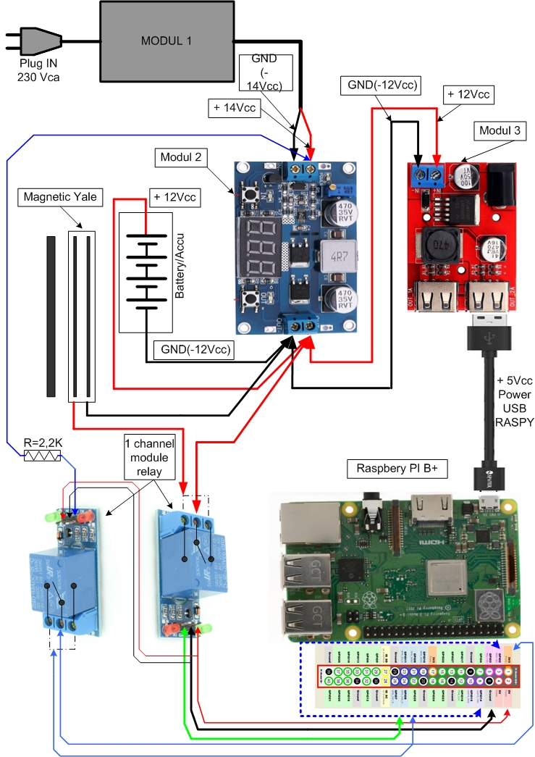
Hardware
Let’s explain a bit the components and what they are doing:
Module 1: PSU Ac/DC 220Vca to 14 Vcc –this will provide power to the whole system and recharge the battery
Module 2: Modular DC/DC converter- this will be used to adjust voltage to make sure nothing will get damaged
Module 3: DC/DC step down converter 12V-5V/3A
Relay modules: These will be the switchers. They- through Pi of course, will notify me when the main power gets cut and will lock/unlock the electronic Yale- as their entrances come from PI.

Slide 10
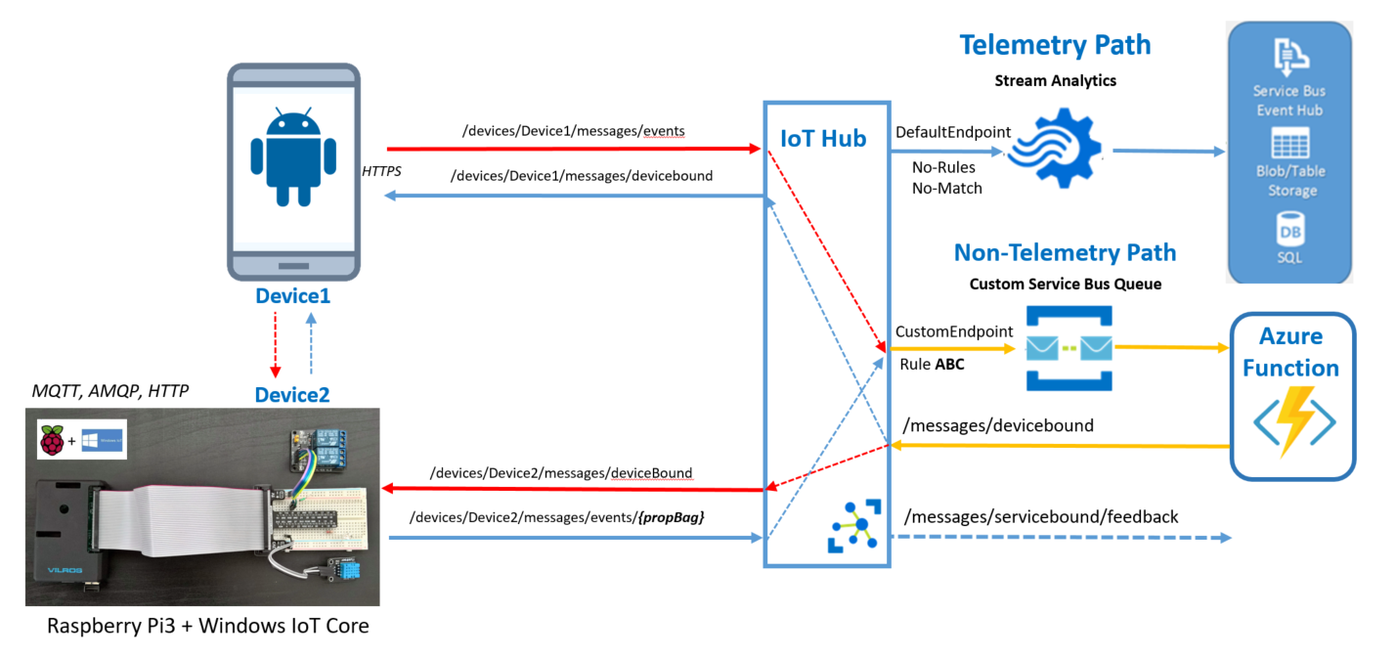
Software-Understanding IoT first
Let me explain a bit what happens here. For example purposes, let’s consider that we want to send a message from Device 1 to Device 2, the only thing we know is the Device 2 name
First we send the message containing the following info:
Payload-the information
Name of the sender-Device 1 along with the
Name of the target-Device 2
Topic-to be routed through the correct rule
The message gets to the IoT hub which looks for the Topic and sends it to the specific topic endpoint.
The endpoint is actually a Service bus Queue on which I have attached a serverless azure function which process the messages in the queue
The azure function then creates a proxy of the IoT Hub in the cloud to be able to forward the message to the target device
Device 2 listens every 10 seconds for messages for it and acts accordingly. In my specific case, it contacts the Pi api server.
The api server controls directly the pins the its controllers so basically a request to open the locker will not only produce a http
response message but actually action the pins of the PI and produce a http response message.

Slide 11
Technologies used along with software design patterns used
Azure services – IoT hub, Serverless Azure Functions, Service bus queues
Xamarin forms for locker app and phone app
Node js for all the cloud apis
.NET Core 2.2 for PI Server
Windows 10 IoT core for the PI OS
Patterns and Architectures
MVVM for architectural pattern of the mobile apps and MVC for api architecture
DI, IOC, Singleton, Façade software design patterns

Slide 12


Results? First images then some videos

Slide 13
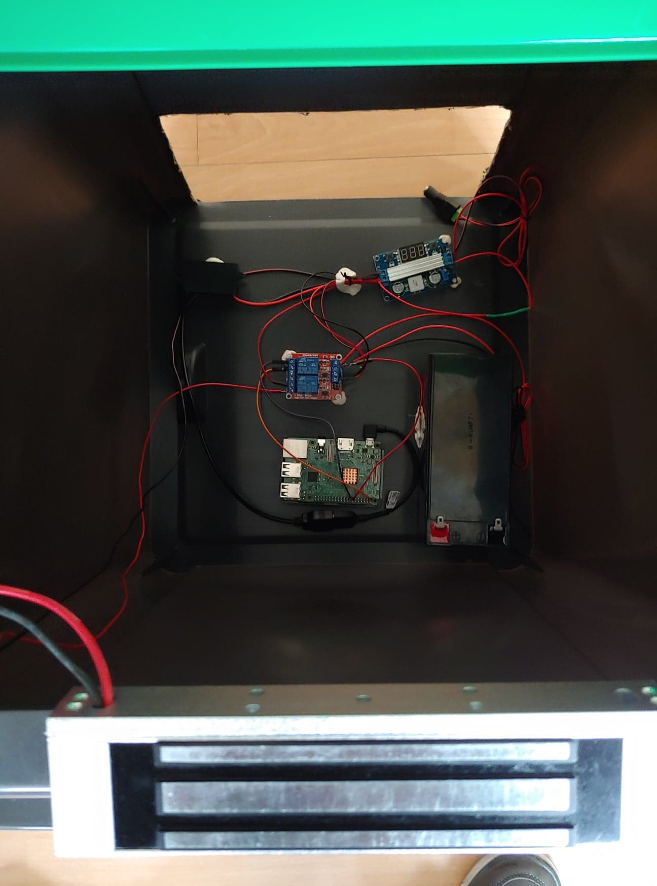
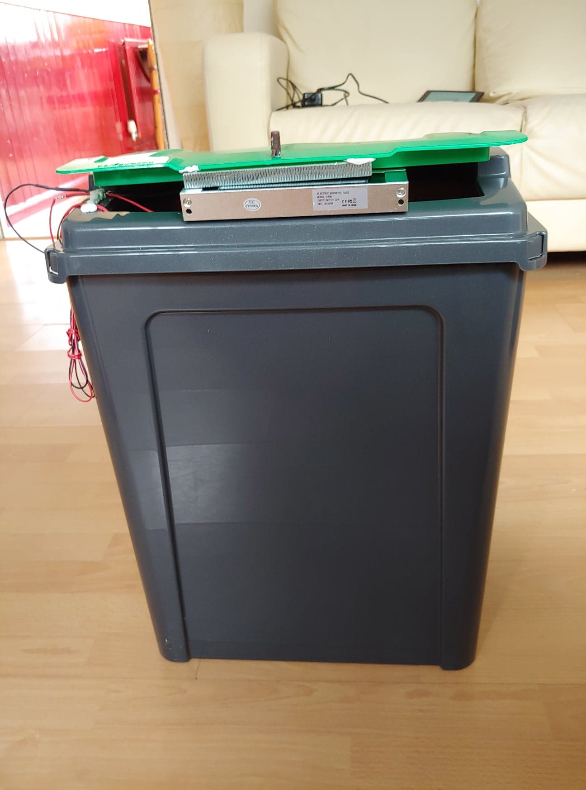

Slide 14
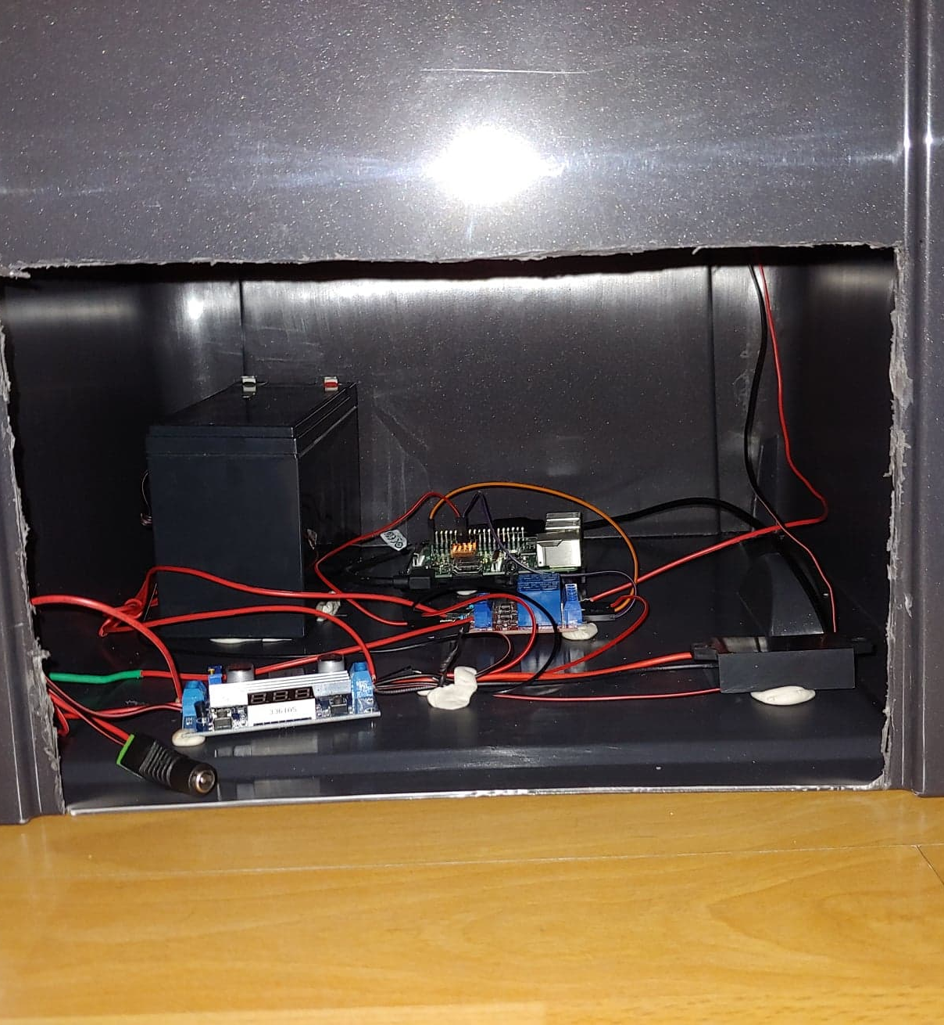
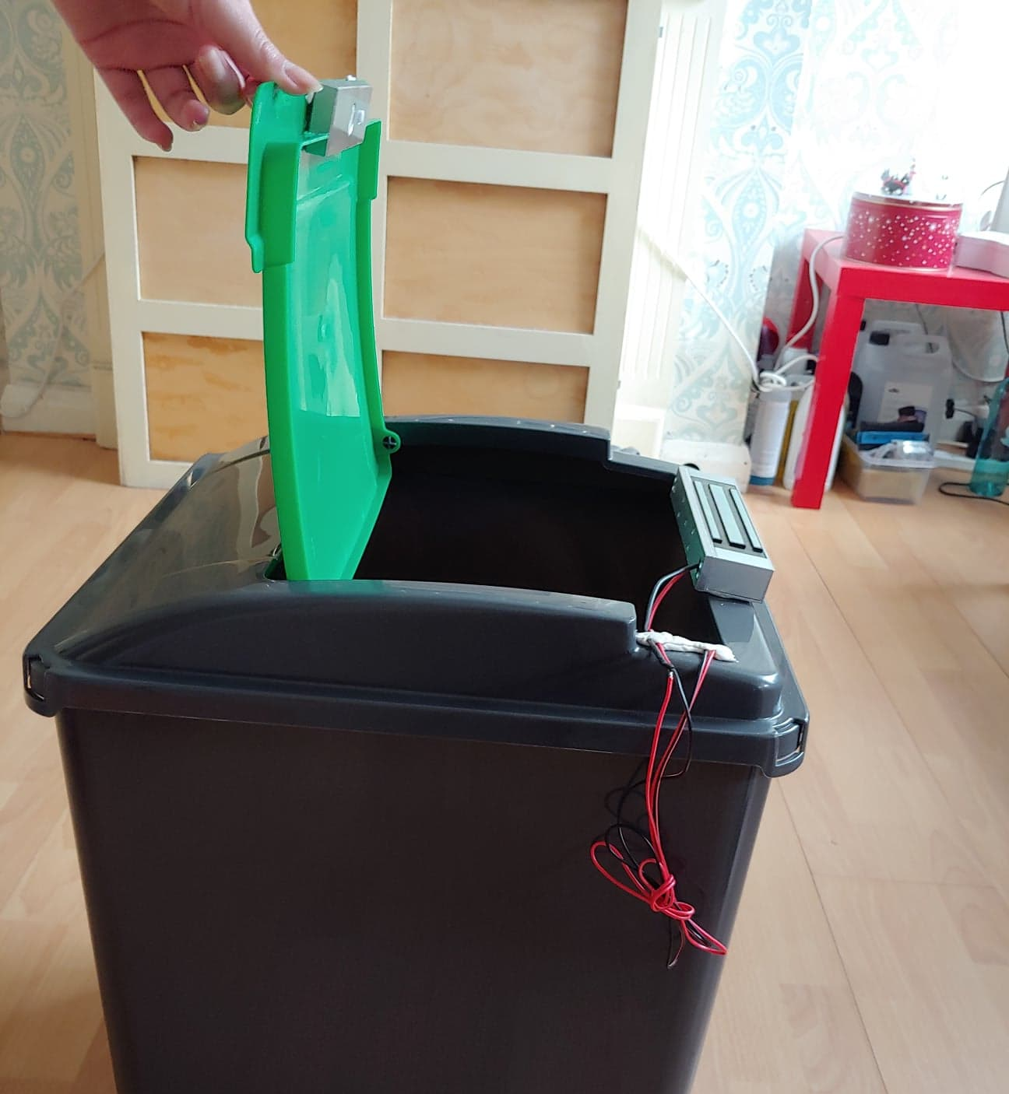

Slide 15
Project management
Github
Trello
Gantt Chart

Slide 16
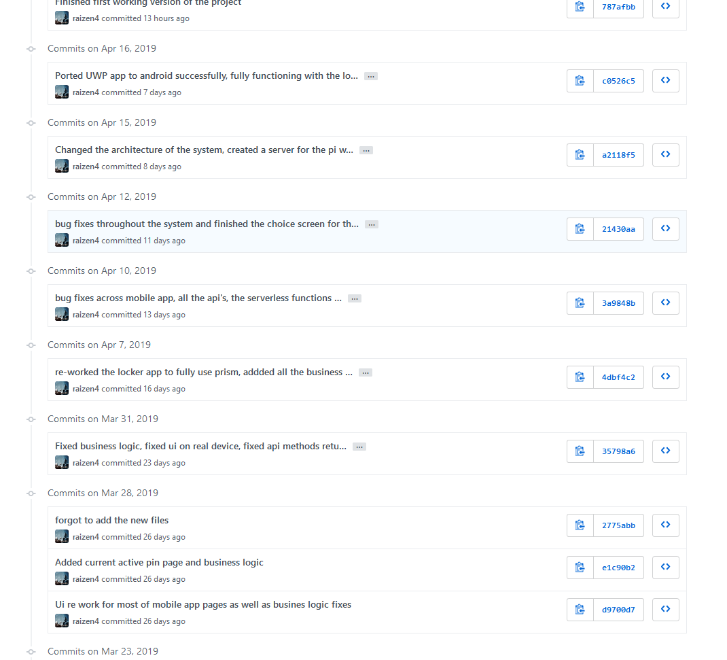
Github

Slide 17
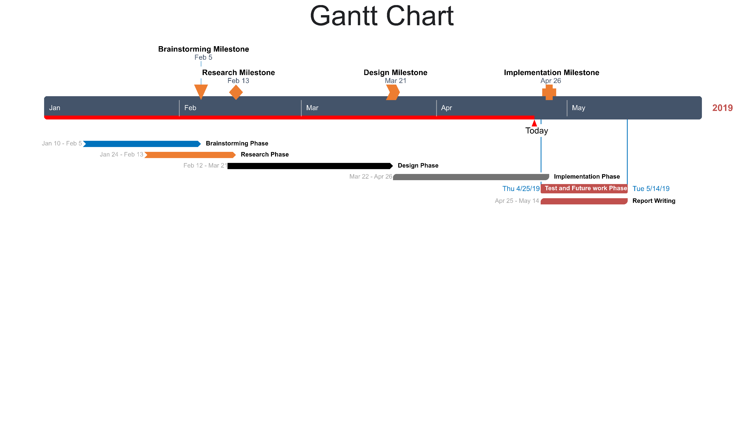

Slide 18

Future work?
May have to better consider security by implementing cameras,
QR codes instead of pins?
What about parcels that need to be picked up by couriers (think of returns) instead of delivered
Better interface and presentation
One app for the locker to ease the maintainability of the whole system

